Slide 1
AIHub
Guided by
Dr. Muhammad Ali Yousuf
DATA606 – Capstone in Data Science, UMBC
Your One-Stop Destination for Machine Learning and Artificial Intelligence
HARIOM VYAS
Notes:
Hello Everyone! I'm Hariom Vyas, and I'm excited to introduce you to an incredible platform that revolutionizes machine learning and AI. Get ready to witness its advancements and possibilities, as it transforms how businesses harness these technologies. Let's embark on this exciting journey together!

Slide 2
PROBLEM
Complexity of Implementation
Lack of a centralized platform and user-friendly tools makes it difficult for them to effectively manage data, perform analysis, and build ML models.
INEFFICIENT Data Management
disparate data sources, inconsistent data quality, or difficulties in integrating and preparing the data for analysis, hindering their ability to derive meaningful insights.
LIMITED ANALYSIS CAPABILITIES
Struggle to extract valuable patterns, trends, and correlations that can drive informed decision-making and business growth.
INADEQUATE DEPLOYMENT & Monitoring
The lack of efficient deployment pipelines and real-time monitoring mechanisms limits their ability to fully leverage the potential of ML models and make timely adjustments to improve accuracy and efficiency.
Notes:
So, before we start, lets talk about the problem statement. Many businesses struggle with the complexities of implementing machine learning and artificial intelligence (AI) solutions. They lack a centralized platform that provides user-friendly tools for data management, analysis, and model building. Additionally, the absence of efficient deployment and monitoring capabilities hampers their ability to fully leverage the power of ML and AI. This results in challenges related to the complexity of implementation, inefficient data management, limited analysis capabilities, and inadequate deployment and monitoring. There is a clear need for a comprehensive solution that simplifies the process, empowers businesses to effectively utilize ML and AI technologies, and addresses these challenges head-on.

Slide 3
SOLUTION
CENTRALIZED PLATFORM
SEAMLESS INTEGRATION
Offers a comprehensive solution for machine learning and artificial intelligence needs.
Seamlessly integrates with existing systems and workflows, ensuring a smooth transition and minimal disruption to business operations.
DEPLOYMENT & MONITORING
COMPETETIVE ADVANTAGE
Robust deployment and monitoring capabilities, allowing businesses to efficiently deploy ML models
Make data-driven decisions, improve operational efficiency, enhance customer experiences, and drive innovation
Notes:
Read the slide

Slide 4

BABY STEPS
DATA MANAGEMENT
Learn to load the data and pre-process it.
DATA ANALYSIS
Get insights from the pre-processed data. Create visuals for aid.
MACHINE LEARNING
Leverage machine learning algorithms
AND BEYOND
Deploy, Monitor and what more can be done?
Resource - https://github.com/hariomvyas/AIhub
Notes:
Creating a platform with such comprehensive features is no small feat. As the saying goes, "dream big, plan diligently, and break the goal into manageable steps." Embracing this wisdom, I embarked on my journey, taking baby steps towards the realization of this ambitious platform. The first crucial step was tackling the intricacies of data management. Once that foundation was laid, the next challenge was harnessing the power of the data and extracting meaningful insights. And what better way to grasp those insights than through visuals? Imagine comparing a table and a chart that present the same data - undoubtedly, the latter would provide a wealth of insights. With the completion of descriptive analysis, the time had come to delve into the realm of predictive analysis, introducing machine learning algorithms to unlock the platform's full potential. As we progress, the possibilities expand, and we eagerly explore the horizons of what more can be achieved. Showcase GitHub Repository.

Slide 5
introduction
AIHub: Your go-to platform for ML and AI. User-friendly interface for data management, analysis, and model building. Future features include deployment and monitoring. Scalable for all businesses. Benefits include faster development and deployment, improved accuracy, and reduced costs.
Notes:
Introducing AIHub: Your ultimate destination for all things machine learning and artificial intelligence. With a user-friendly interface designed for seamless data management, analysis, and model building, AIHub empowers businesses of all sizes to unlock the full potential of ML and AI. But that's not all! We have exciting future features in the pipeline, including effortless deployment and real-time monitoring. AIHub is scalable, catering to the diverse needs of various industries. By leveraging AIHub, businesses can experience accelerated development and deployment, heightened accuracy in predictions, and significant cost reductions. Get ready to revolutionize your approach to ML and AI with AIHub.

Slide 6
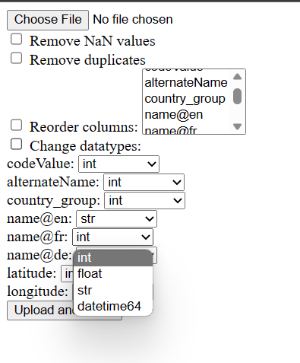
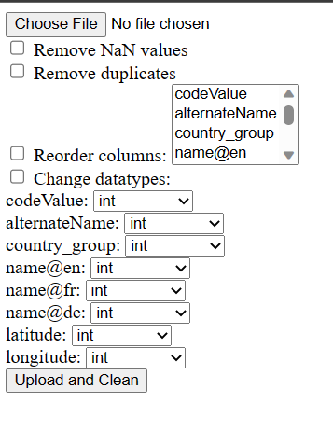
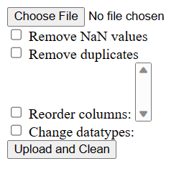
Notes:
Just like Rome, AIHub wasn't built overnight. It required multiple approaches, trial and error to reach version 1 with basic functionalities.

Slide 7
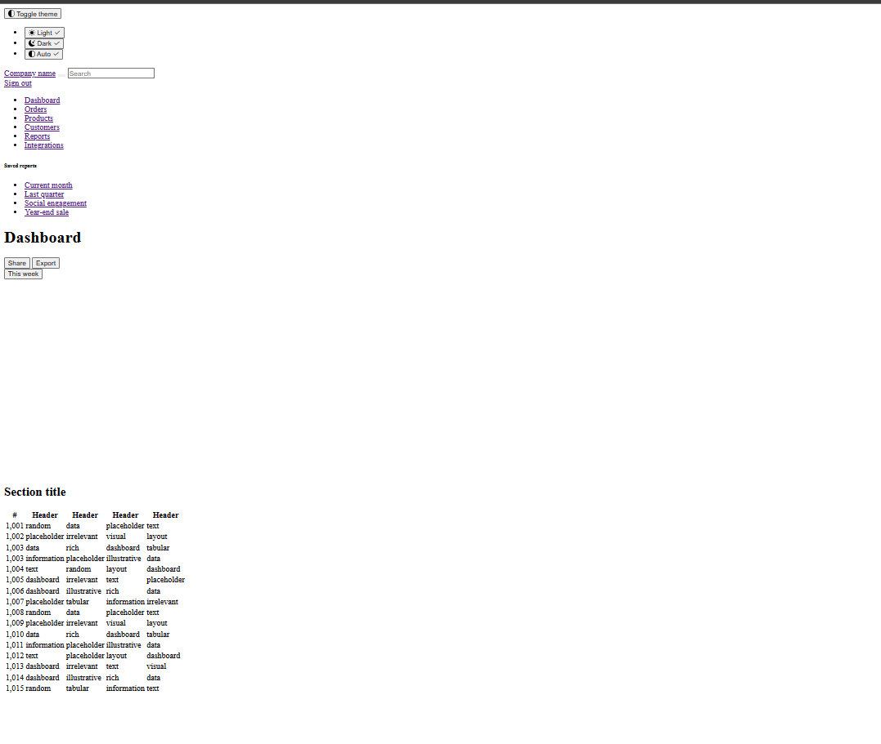
Notes:
Just like Rome, AIHub wasn't built overnight. It required multiple approaches, trial and error to reach version 1 with basic functionalities.

Slide 8
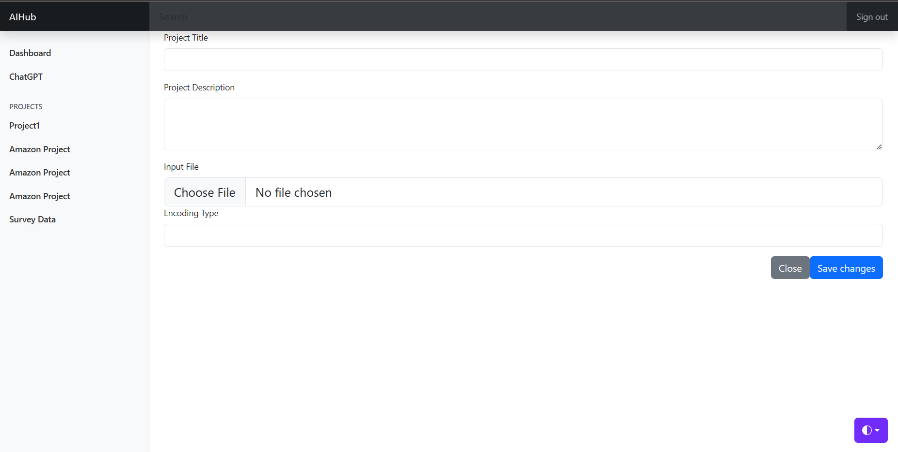
Notes:
Just like Rome, AIHub wasn't built overnight. It required multiple approaches, trial and error to reach version 1 with basic functionalities.

Slide 9
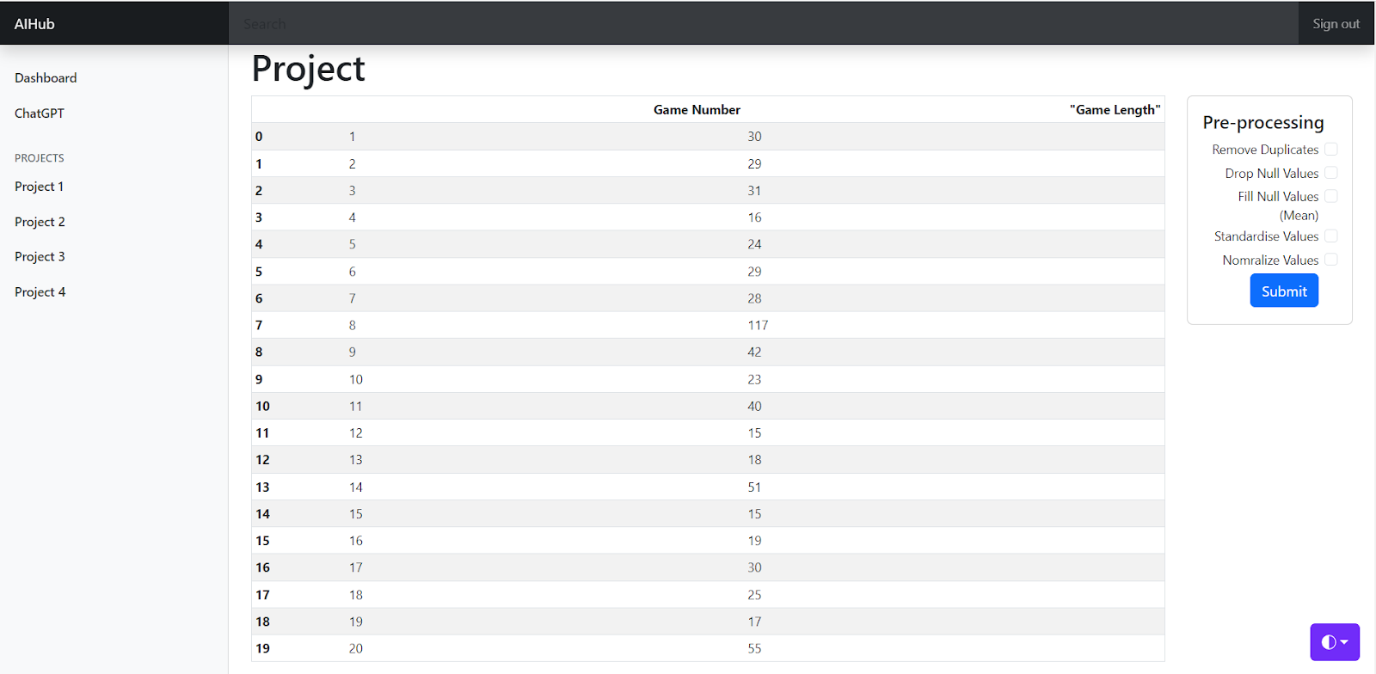
Notes:
Just like Rome, AIHub wasn't built overnight. It required multiple approaches, trial and error to reach version 1 with basic functionalities.

Slide 10
AIHUB
Notes:
Demo of Platform

Slide 11
MEET THE TEAM
Hariom Vyas
Internet
Data Scientist / Web Developer
Knowledge Partner
Stack overflow
ChatGPT
Problem Solver
Assistant / Content Writer
Notes:
Meet the Team.

Slide 12
SUMMARY
AIHub simplifies ML and AI implementation for businesses. With user-friendly tools, it streamlines data management, analysis, and model building. Seamlessly integrating with existing systems. Gain a competitive advantage, make data-driven decisions, and drive innovation. In the future, we aim to expand with efficient deployment and monitoring features, advanced AI algorithms, automated model training, and enhanced collaboration features.
Notes:
AIHub simplifies ML and AI implementation for businesses. With user-friendly tools, it streamlines data management, analysis, and model building. Seamlessly integrating with existing systems. Gain a competitive advantage, make data-driven decisions, and drive innovation. In the future, we aim to expand with efficient deployment and monitoring features, advanced AI algorithms, automated model training, and enhanced collaboration features.

Slide 13
THANK YOU
Hariom Vyas
hariomvyas@umbc.edu
www.hariomvyas.com

